Slide 1

SR UNIVERSITY
ANANTHASAGAR

Slide 2
TITLE:
TITLE:COWIN
TEAM MEMBERS:
KANALA BHARGAV REDDY 2103A51048
MUDURUKOLLA KRISHNA 2103A51060
ALLADI JAYANTH 2103A51503
JENNAPUREDDY SANTHOSH 2103A51517
UNDER THE GUIDANCE OF: CH.SANDEEP

Slide 3
ABSTRACT:
This webpage is about the COWIN
On March 11,2020 covid-19 was officially characterised as a pandemic by the World Health Oraganisation(WHO)
Covid-19 is a part of family of viruses which cause various illness.The serevity of illness is varied,ranging from mild effects to serve,with some cases even being linked to deaths.
The pandemic has impacted both lives and livelihood by causing health care challenges and humanitarian crisis.

Slide 4
MAIN PAGE:
In our website the main page is “COWIN” page .It contains a navigation to total number of 6 web pages they are :ABHA(Health id),Dashboard,Verify certificate,FAQ’s,Partners,Registration/Sign in.
The background image of our website interface is “eagle with indian flag colours”.

Slide 5
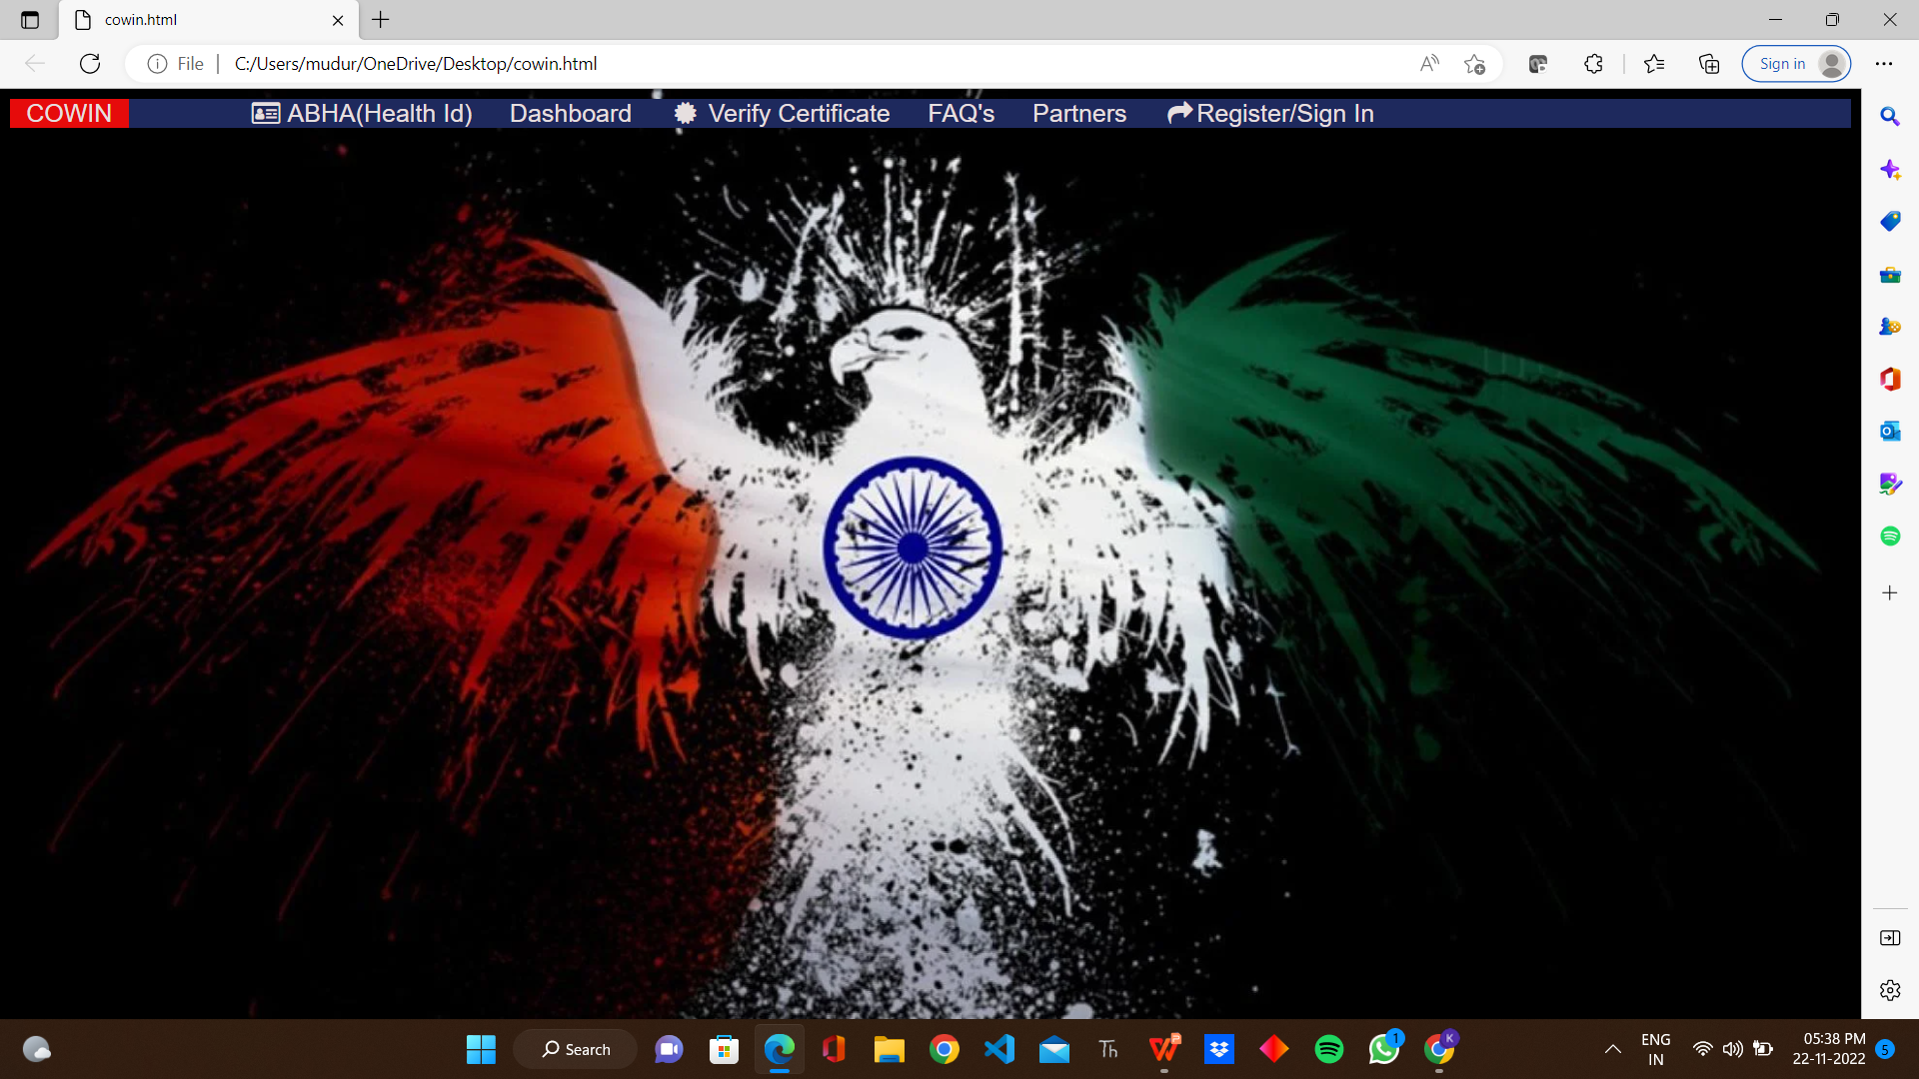
HOME PAGE:

Slide 6
ABHA(Health Id):
The first page of our web site is “ABHA(Health id)”.
ABHA stands for Ayushman Bharat Health Account
It is a page where user login for vaccine with ABHA number and with their year of birth
It also verifies whether the user is robot or not and their is a option continue,if user click on the
continue button it will navigate for further process.
The background colour code for this page is ”#D2B4DE”.
The text in ABHA(Health id) is left aligned and the front style used in this page is bold and calibri
we can also navigate from this page to any of the other page in our website.

Slide 19
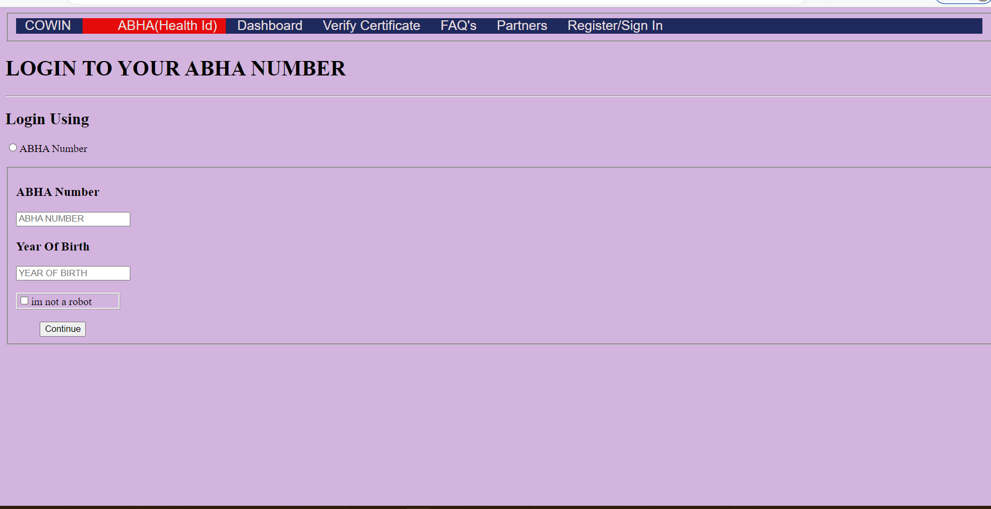
ABHA(Health-ID:

Slide 20
DASHBOARD:
This page of our website is “Dashboard”.
This page contains total no.of registrations, vaccinations,fully vaccinated, partially vaccinated, age group wise vaccinations, precaution doses and also contains the sites conducting vaccinations.
The all above details are displayed with graphs.
we can navigate from this page to any of the page in our website.

Slide 21
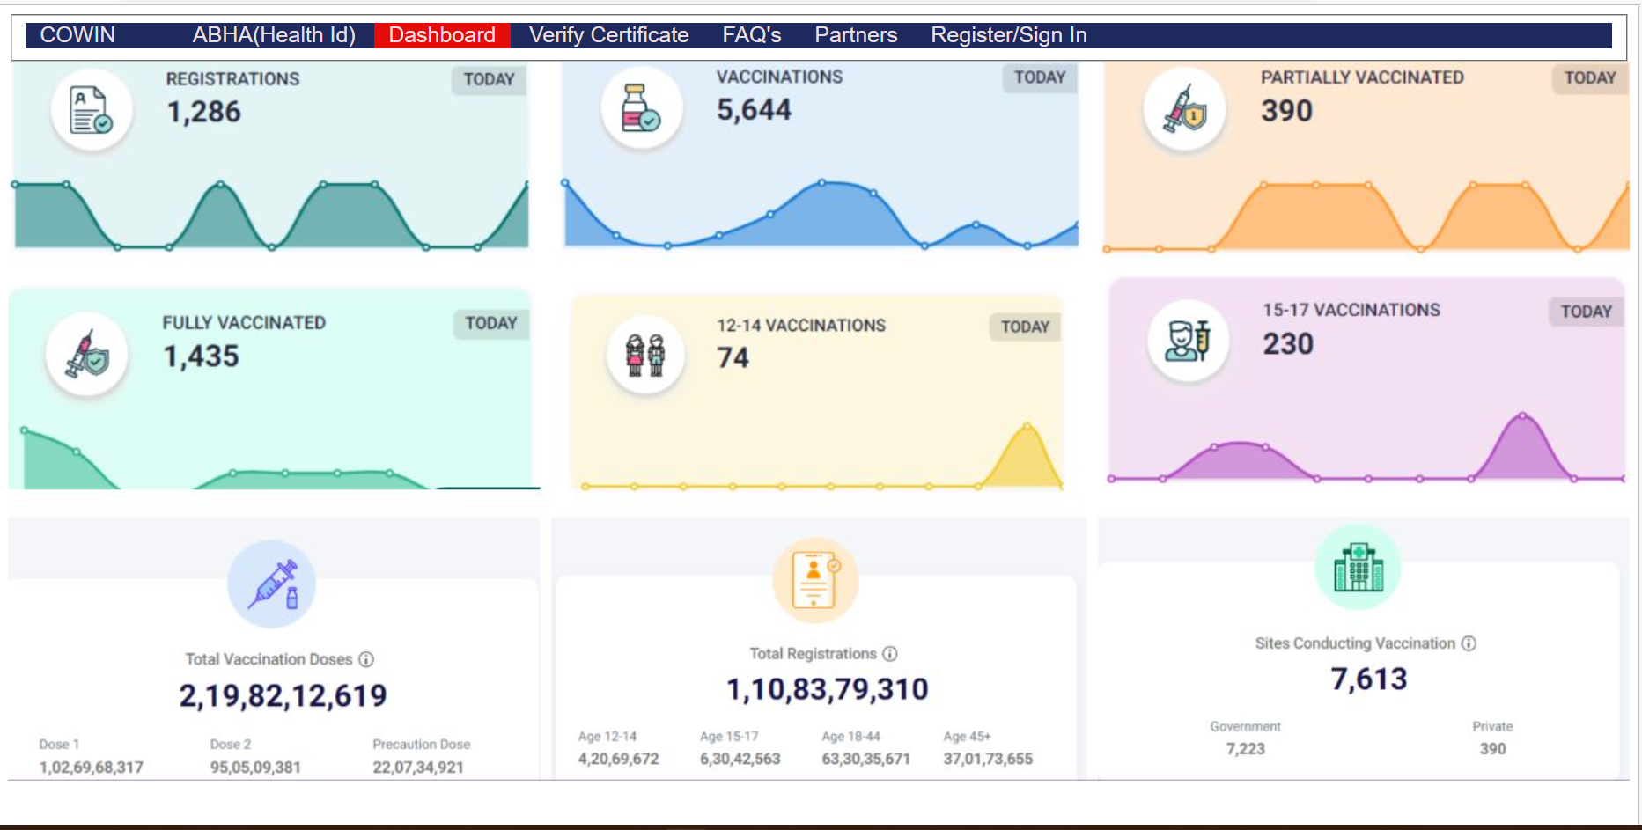
DASH BOARD:

Slide 22
Verify certificate:
This page in our website is “verify certificate”.
This page is used to verify the certificate taken after vaccination by the users.
we can scan the certificate by allowing permissions to the camera or we can choose a file from our mobile or a desktop.
we can get the information of user by scanning the certificate .
The background image of this page is a certificate .
we can also navigate from this page to any of the page in our website.

Slide 23
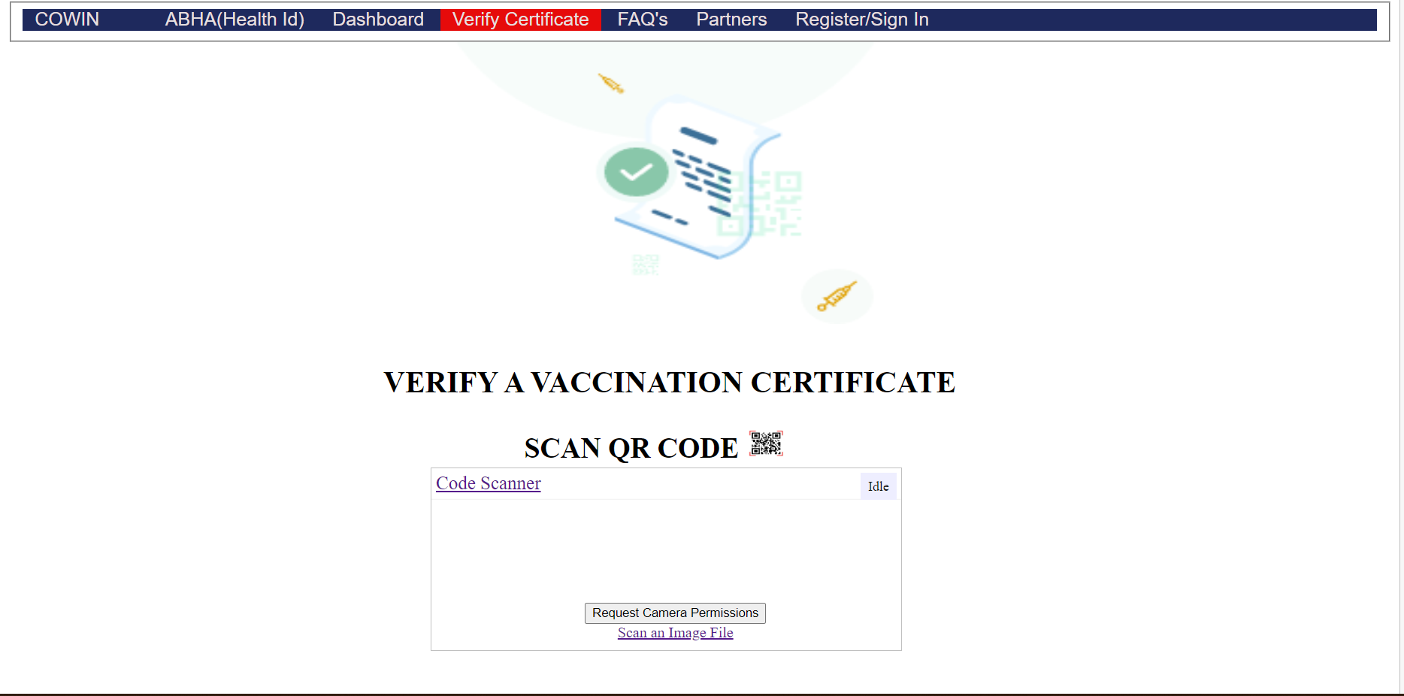
Certificate Verification:

Slide 24
FAQ:
This page in our website is “FAQ’s”.
This contains about Frequently Asked Questions.
when the user is ambigious about the website ,he/she can clearly clarifies the quetions from the FAQ’s Webpage.
Like:
How many members can register using a single mobile Number?
what is the Minimum age to register a vaccination?
we can also navigate from this page to any other page of our website.

Slide 25
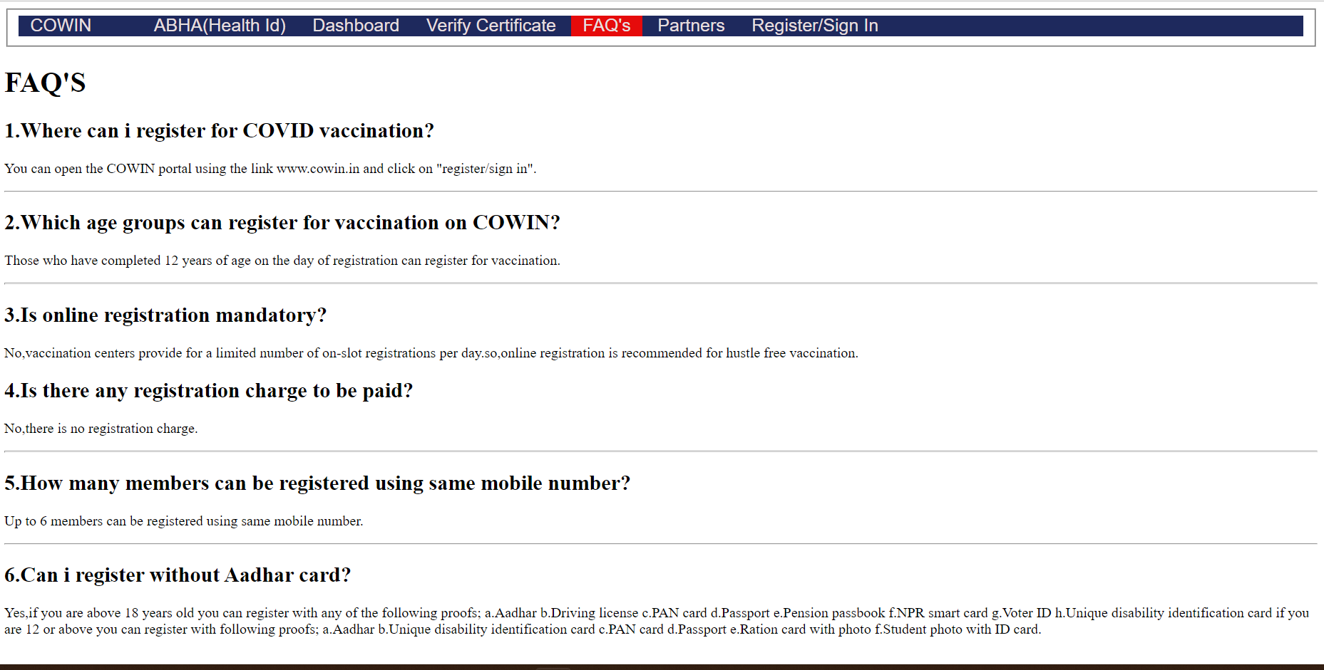
FAQ’s:

Slide 26
PARTNERS:
This page of our website is “partners”.
our partners are:Digilocker,Aarogya setu,my gov,Jio,Step One,TRIGYN,Health,Whats app,Apollo,National health mession,Pulse.
we can also navigate from this page to any other page of our website.

Slide 27
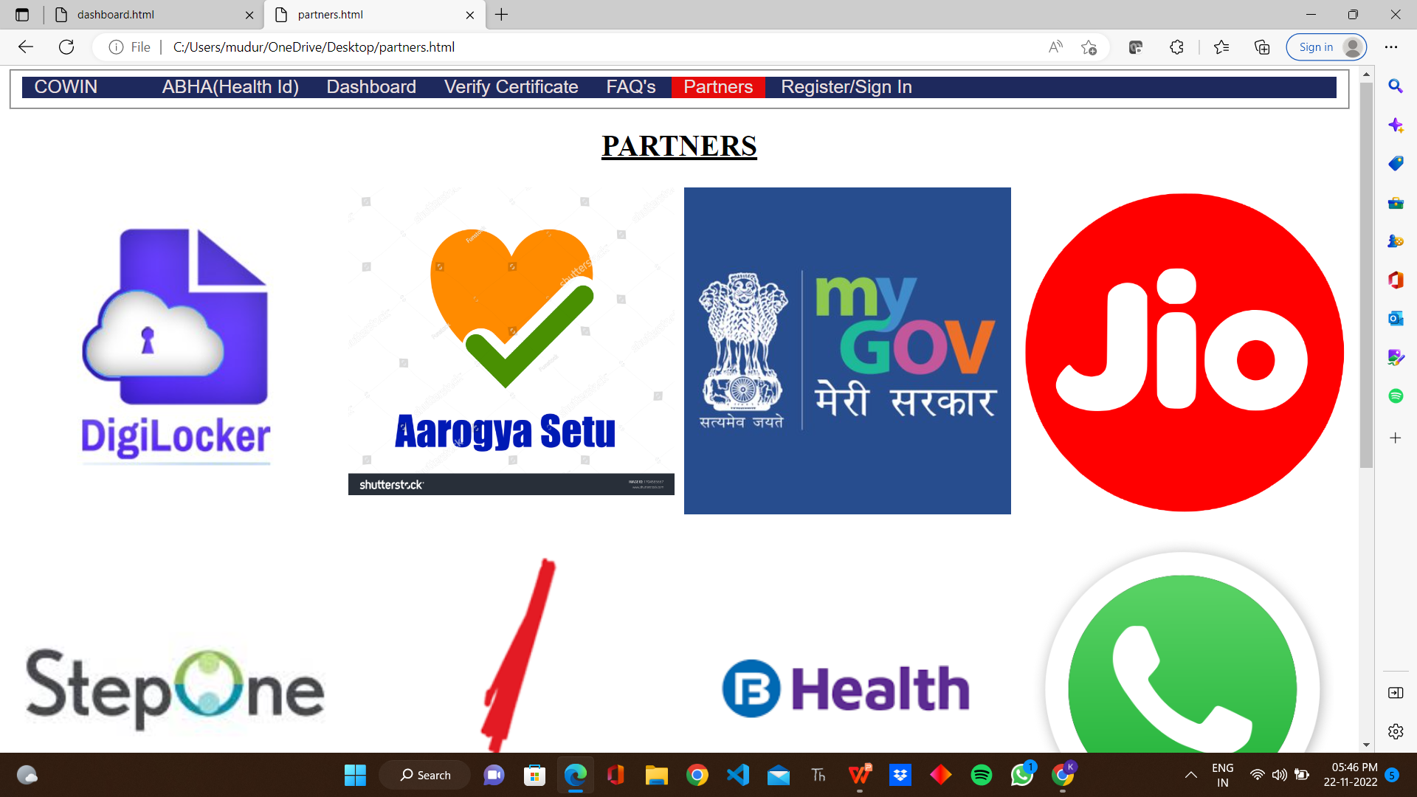
PARTNERS:

Slide 28
REGISTER/SIGN-IN:
This page of our website is “Register/Sign in”.
This page is used to user can fill the form by register/sign in the site .
we can register/sign in with our name,mobile number and Adhar number.
click on the sign up button to register your details in the site.
we can also navigate from this page to any other page of our website.

Slide 29
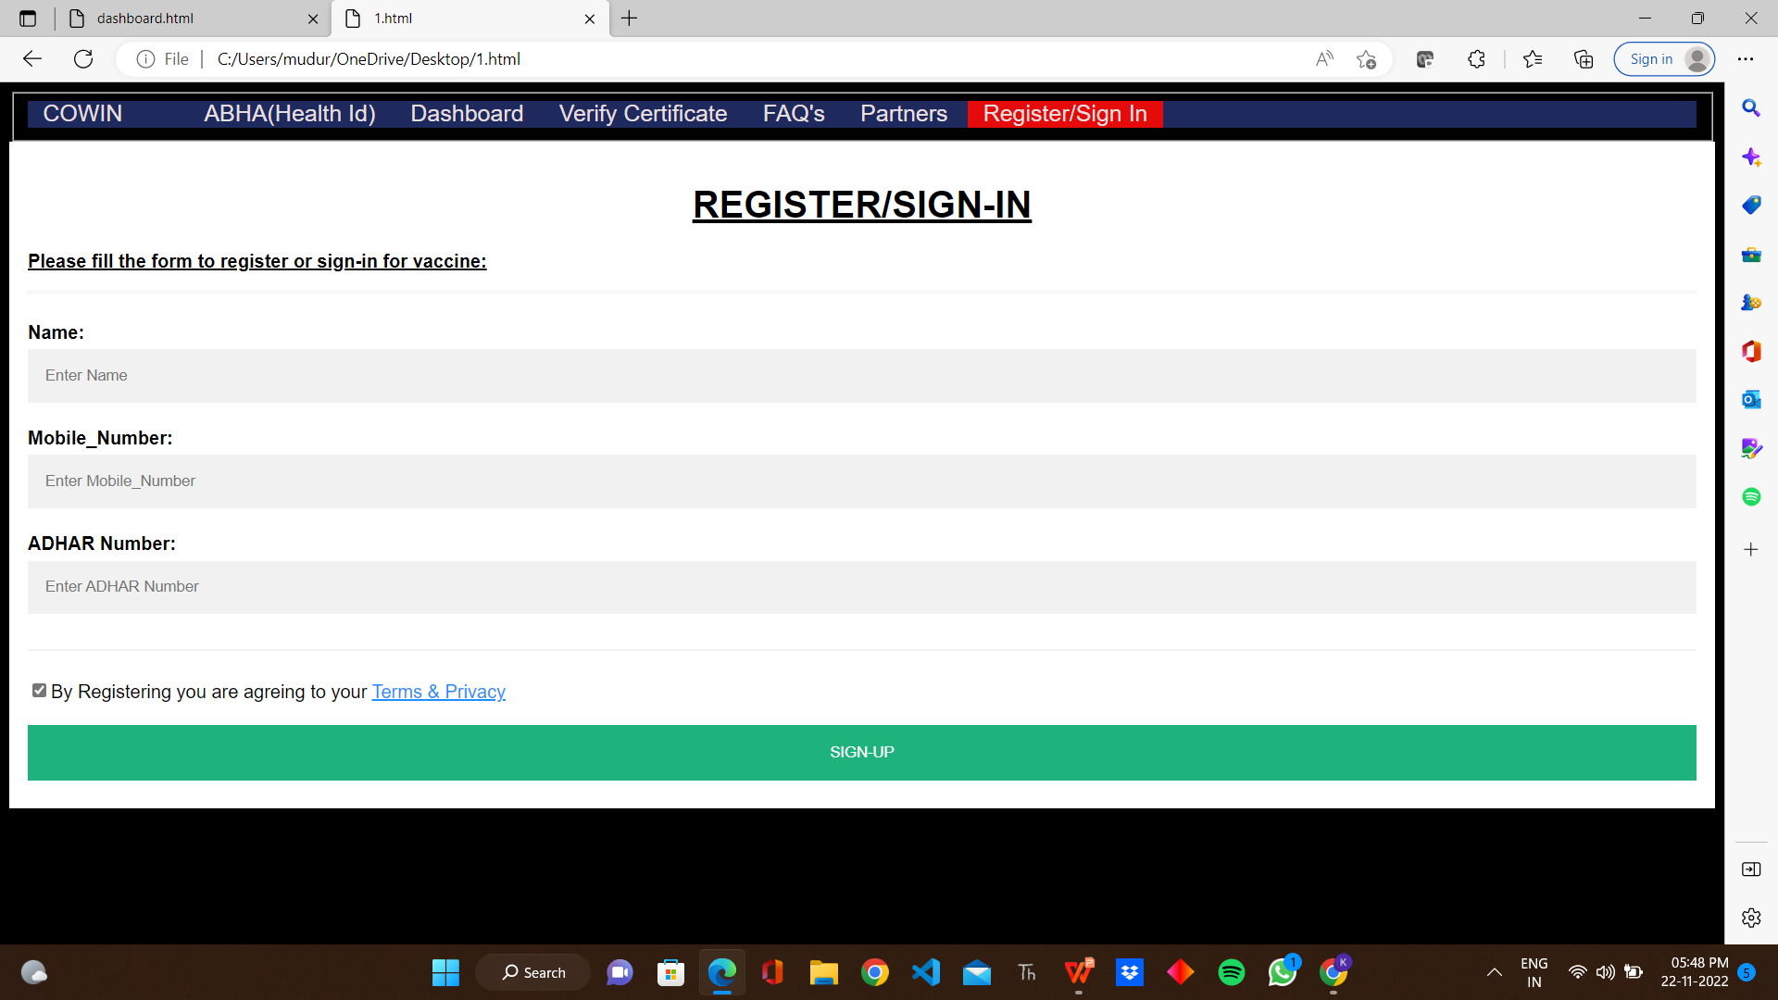
REGISTER/SING-IN:

Slide 30
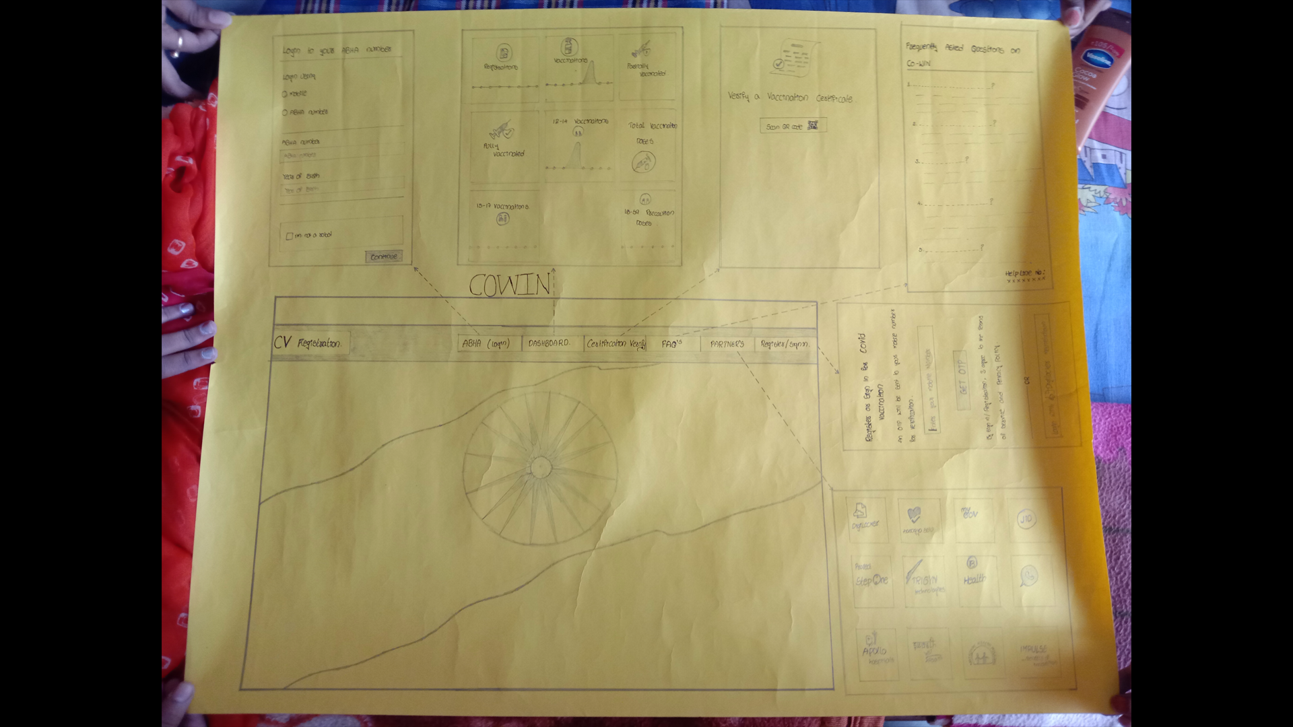
ARCHITECTURAL DESIGN:

Slide 31
CONCLUSION & FUTURE SCOPE:
We Conclude that this website is useful for conducting Hustle free vaccinations by pre registering the vaccination slot through this website
This shows the rate of vaccinations registered as per different age groups like teen,youth,young etc.
This helps us to overcome the spread of deadly diseases like covid-19

Slide 32
***THANK YOU***

